Slide 1
Influence of growth history on sea ice salinity
Master Thesis Proposal Talk
Supervisors: Prof. Dirk Notz & Dr. Niels Fuchs
by: Jakob Pfannschmidt

Slide 2
Sea Ice in a warming Climate
Salt output
Research question
Model setup
Preliminary results
Outlook

Slide 3
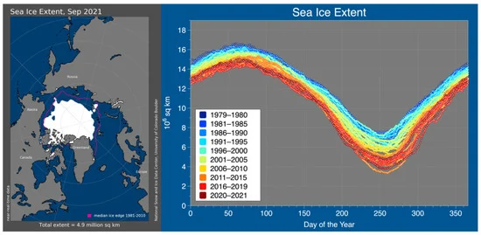
Sea Ice in a warming Climate
Sea Ice drives Thermohaline Circulation
  Brine rejection
Decline in sea ice area coverage
Salt input from sea ice depends on sea ice evolution
[1]
[2]
Notes:
Sea ice is an important part of the climate system

Slide 4
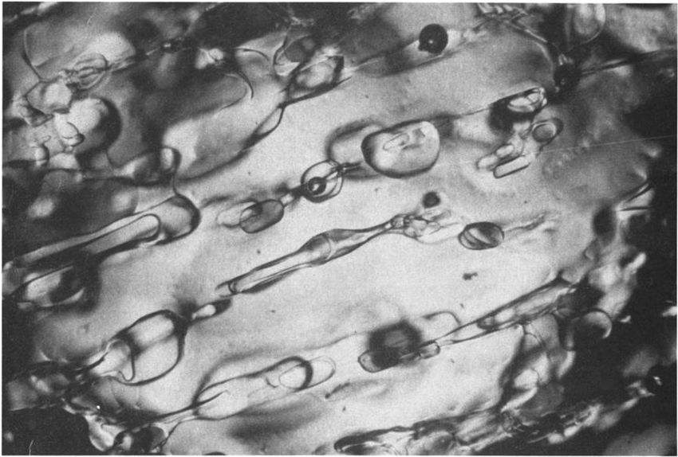
Sea Ice Salinity
Formation of brine inclusions during freezing
Desalination of brine inclusions into ocean
  Gravity drainage is the most important process of desalination [3]
Salinity depends on:
  Ice thickness
  Temperature (warmer ice is more porous)
[4]
Notes:
Salinity in sea ice is strongly dependent on ice thickness
Quantification of salt loss depending on growth history

Slide 5
What are the drivers of salt rejection?
Ice thickness
Temperature and growing conditions
Assume: 1m thick ice, can we estimate salinity only from thickness, or do we need to know growth history?
Notes:
Ice thickness as ice loses salt significantly while growing
Growing conditions
Parameterization used in a lot of climate models is that warmer temperatures mean more salt output
Is that true?

Slide 6
Research question
How does the desalination through gravity drainage differ between rapid (cold) and slow (warm) ice growth conditions?
or
Is it possible to use sea ice thickness to get a rough estimate of the sea ice salinity regardless of the growth history?
S ~ S(sea ice thickness)

Slide 7
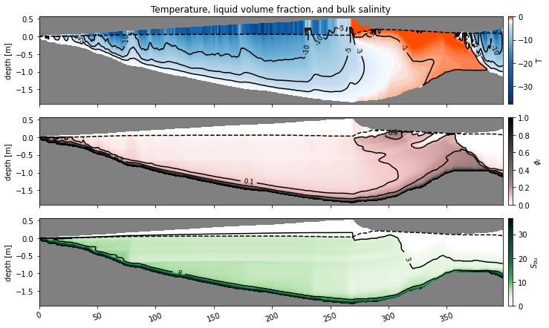
Sea Ice Model set up
SAMSIM (Semi-Adaptive Multi-phase Sea Ice Model):
  1D sea ice model studying the effect of gravity drainage
First year ice starting Sep. 2019
MOSAiC observational data as forcing:
  Temperature at 2m
  Heatfluxes (longwave, shortwave, sensible, latent)
  Snow precipitation

Slide 8
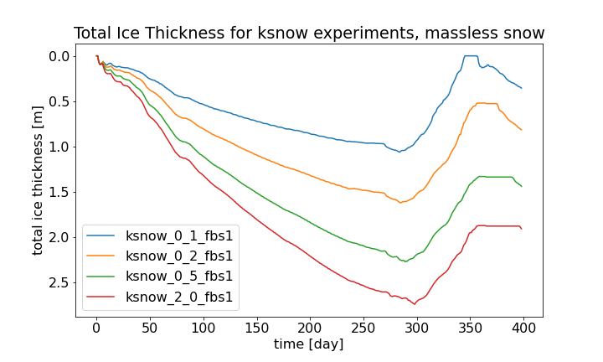
Simulating different growth histories
modify forcing by insulating the ice from atmospheric forcing
Snow cover as insulator
Constant snow depth
vary snow heat conductivity
  0.1-2.0 W/mK
Assume massless snow

Slide 9
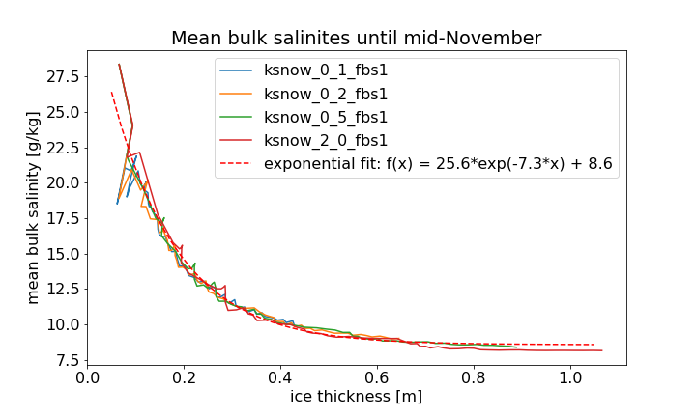
Mean Bulk Salinity
Mean bulk salinity over entire ice column
Compare same thickness of ice depending on growth ratio
  -> S(d_ice)
Parameterization S=S(d_ice)
  salinity is only dependent on ice thickness, regardless of grwoth history
Check limitations and try to break the parameterization

Slide 10
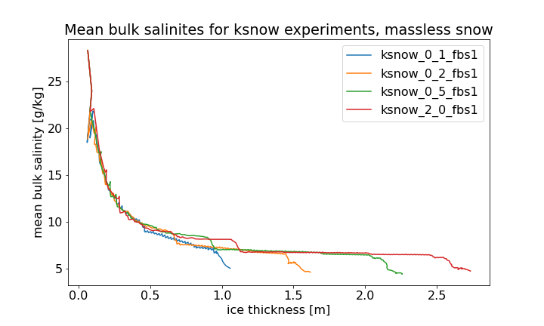
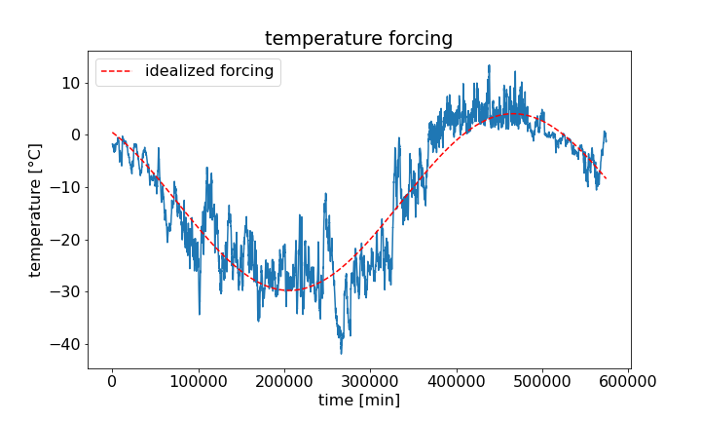
Warm events
Warmer temperatures make ice more porous
  -> more ice loss, lower mean bulk salinities
  Deviation from the parameterization
Getting rid of warm events by idealizing MOSAiC seasonal forcing with a sin-fit

Slide 11
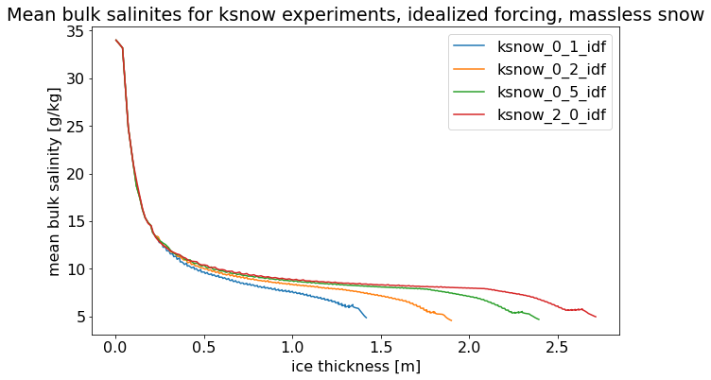
Idealized atmospheric forcing
Notes:
Deviation towards higher ice thicknesses due to warming surrounding and bigger gravity drainage

Slide 12
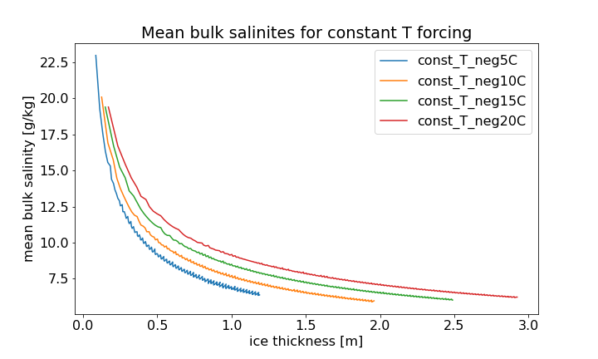
Constant temperature forcing
Getting rid of seasonality
Only forcing is constant T_top
defer from parameterization
  Lower temperatures on top lead to ice being less porous on top, keeping more salinity

Slide 13
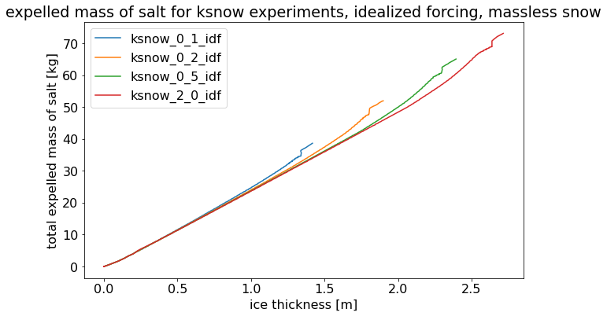
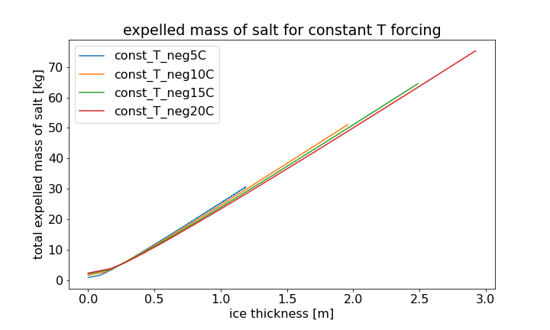
Mass of expelled salt
Total mass of salt expelled out of sea ice per m²
Important quantity for oceanic processes
Help parameterize salt input into ocean for ocean models

Slide 14
Perspective
Find limitations and constraints of S = S(d_ice) parameterization
Is there a way to include warm events into the parameterization?
Constant T experiments with seasonality
  Constant offset in seasonality
Include controlled warming events into the idealized/constant forcing

Slide 15
Thank you for listening

Slide 16
References
[1] Stewart, K. D., Palm, W., Shakespeare, C. J., Kraitzman, N., & Stewart, K. (2023). The Sensitivity of Sea Ice Brine Fraction to the Freezing Temperature and Orientation. Journal of Glaciology, 00(000), 0. https://arxiv.org/abs/2310.07072v1
[2] Bennett, A. P., Bouffard, T. J., & Bhatt, U. S. (2022). Arctic Sea Ice Decline and Geoengineering Solutions: Cascading Security and Ethical Considerations. Challenges 2022, Vol. 13, Page 22, 13(1), 22. https://doi.org/10.3390/CHALLE13010022
[3] Notz, D., & Worster, M. G. (2009). Desalination processes of sea ice revisited. J. Geophys. Res, 114, 5006. https://doi.org/10.1029/2008JC004885
[4] Golden, K. M., & Ackley, S. F. (1980). MODELING OF ANISOTROPIC ELECTROMAGNETIC REFLECTION FROM SEA ICE. CRREL Report (US Army Cold Regions Research and Engineering Laboratory), 80–23. https://doi.org/10.1029/JC086IC09P08107
[5] Griewank, P. J., & Notz, D. (2015). A 1-D modelling study of Arctic sea-ice salinity. Cryosphere, 9(1), 305–329. https://doi.org/10.5194/TC-9-305-2015

Slide 17
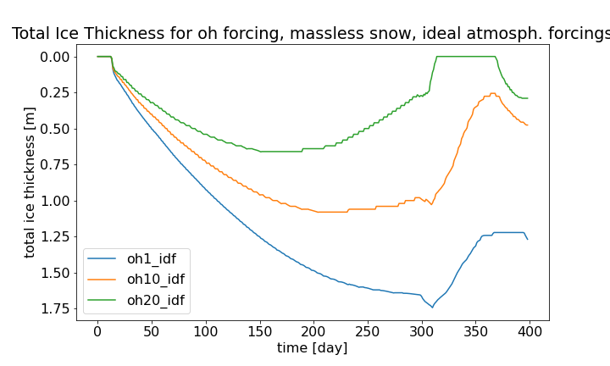
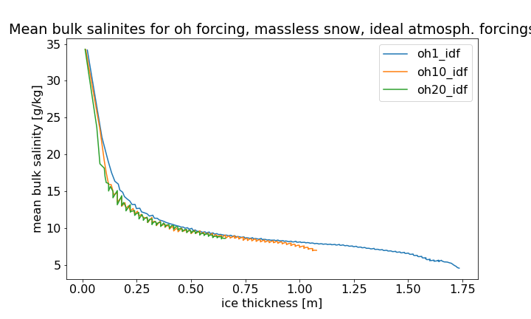
Oceanic heating
Snow heat conductivity dampens signals in atmospheric forcing depending on k
-> keep snow insulation constant
Vary ice growth from the bottom by varying oceanic heatflux

